Slide 1
AI System Auditing: Ensuring Fairness in Recruitment Models
Team Members: Levi Lazarus, Charan Putta, Yashwanth Phanindra, Navya Nelluri
Course: Internship_660
Date: 5/6/25

Slide 2
Why AI Auditing Matters
AI systems are used in hiring, healthcare, finance, and more.​
Bias in training data can lead to unfair decisions.​
Complex models (like Random Forest) lack transparency.​
Legal frameworks demand fairness and explainability.​
Auditing builds trust and helps catch hidden risks.

Slide 3
Real-world examples
Amazon Hiring AI: Biased against female candidates.​
Tesla Autopilot: Misidentified objects — caused crashes.​
Healthcare AI: Underdiagnosed minorities in prediction tools.​
Deepfakes: AI-generated fake content used in scams and disinformation.

Slide 4
AI Standards & Challenges
NIST AI Risk Management Framework – U.S. government guidelines for trustworthy AI.​
ISO/IEC 42001 – Global standard for AI management systems.​
IEEE 7000 Series – Focuses on AI ethics and transparency.​
Key challenges:​
Model bias and fairness​
Lack of interpretability​
Data poisoning & adversarial attacks​

Slide 5
Recruitment Dataset Overview
Purpose
Predict hiring outcomes based on candidate attributes.
Explore factors that influence hiring decisions using machine learning models.
Dataset Details
Records: 1,500 candidates
Features: 10 input attributes
Target Variable: HiringDecision (0 = Not Hired, 1 = Hired)
Key Variables
Age, Gender, Education Level, Experience Years
Previous Companies, Distance From Company
Interview Score, Skill Score, Personality Score
Recruitment Strategy (Aggressive, Moderate, Conservative)

Slide 6
Data Preprocessing ​
Initial Data Checks
Loaded the recruitment dataset using pandas.
Confirmed there were no missing values and all data types were appropriate Except DistanceFromCompany and Gender.
Target column HiringDecision showed class imbalance:
69% Not Hired (0), 31% Hired (1)
Data Type Conversions
Converted DistanceFromCompany and Gender columns from float to int and object to int for consistency and interpretability.

Slide 7

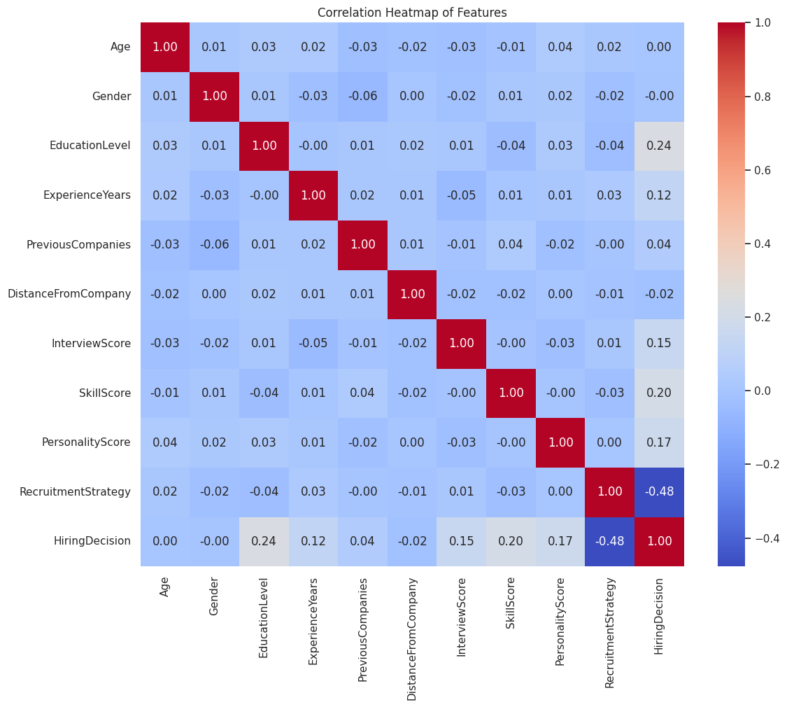
Correlation Analysis
Displays pairwise correlations between all features and the target (HiringDecision).
Values range from -1 (strong negative) to +1 (strong positive).
Helps identify which features are influential, redundant, or potentially problematic (due to multicollinearity).

Slide 8
Applied one-hot encoding to the RecruitmentStrategy column:
Transformed it into RecruitmentStrategy_2 and RecruitmentStrategy_3.
drop_first=True used to avoid multicollinearity (dummy variable trap).
Feature Scaling & Dataset Splitting
Applied StandardScaler to numeric columns:
Transformed features to have mean = 0 and standard deviation = 1.
Helps ensure all features contribute equally during model training.
Crucially for models like Logistic Regression
Divided the dataset using train_test_split:
80% training, 20% testing
Ensures unbiased model evaluation and reproducibility (random_state=42)
Guarantees that the model generalizes well to unseen data

Slide 9
Models We Audited​
Logistic Regression​
Simple, interpretable, good for baseline​
Decision Tree​
Handles non-linear patterns, easy to visualize​
Random Forest​
High accuracy, complex ensemble model​

Slide 10
Evaluation Results​
Logistic Regression​
Accuracy: 91%​
Good baseline, interpretable coefficients​
Decision Tree​
Accuracy: 88.3%​
Slightly lower performance, visible bias​
Random Forest​
Accuracy: 93%​
Best performance, explained using SHAP​

Slide 11
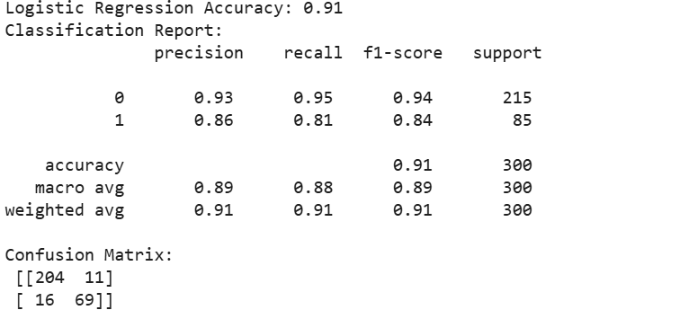
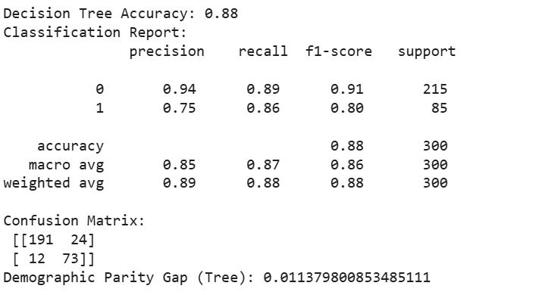
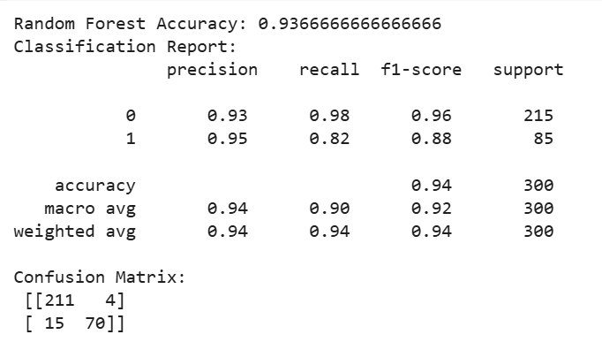

Slide 12
Fairness Testing​
Audited fairness using Demographic Parity Gap​
Measures the difference in positive predictions between groups (e.g., Gender)​
Decision Tree gap: 0.0183 → showed bias​
Random Forest gap: 0.0065 → fair and balanced​
Logistic Regression: gap reviewed using coefficient impact​

Slide 13
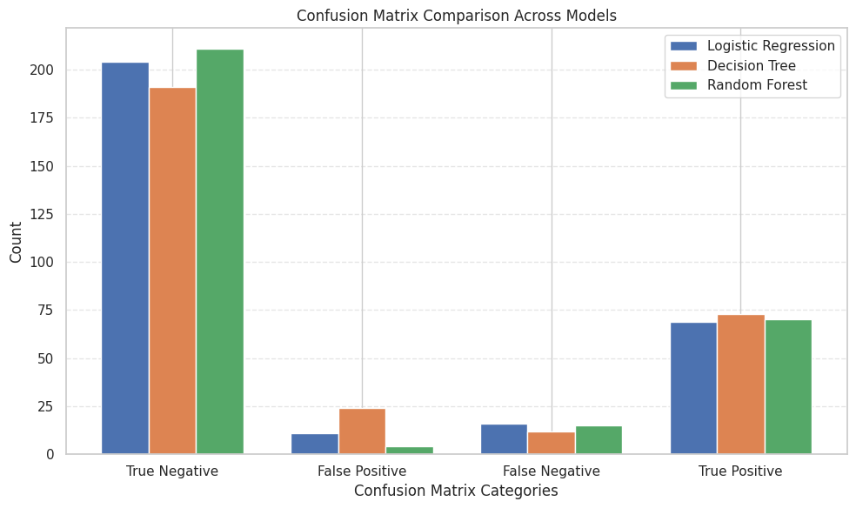
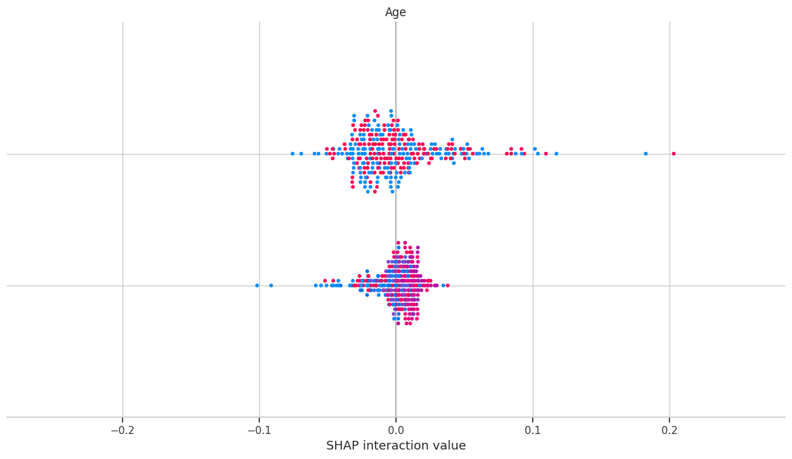

Slide 14
Bias Mitigation Techniques​
SMOTE: Handled class imbalance in Decision Tree​
SHAP: Explained feature impact in Random Forest​
Logistic Regression: Evaluated fairness via coefficients​
Each model had specific flaws addressed differently​
Goal: Improve both fairness and transparency​

Slide 15
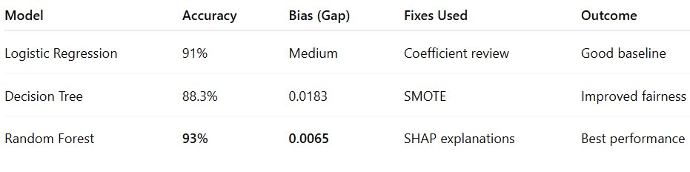
Which Model Performed Best?​

Slide 16
ConcLUsion​
Random Forest achieved the highest accuracy (93%) and the lowest bias​
SHAP helped explain and audit complex model decisions​
Fairness tested using the Demographic Parity Gap​
Bias mitigation is model-specific (e.g., SMOTE, SHAP, coefficients)​
AI auditing is essential for trust, transparency, and ethics​

